Slide 1
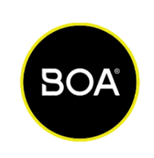


STRATEGY DECK
Notes:
Good morning, everyone. My name is Diego, and I want to first thank you for this opportunity. Before we dive into the details, let's take a look at the agenda for today's presentation.

Slide 2
01
INTRODUCTION
02
CONTEXT
03
METHODOLOGY
AGENDA
04
BOA BUSINESS INSIGHTS
05
STRATEGIC BUSINESS ANALYSIS
06
LONG TERM BUSINESS PLANNING
07
Q&A
Notes:
We will cover the following points:
Introduction - A brief overview of myself.
Context - A brief overview of the data set, an explanation of the key variables in the data set, a breakdown of the three main parts of the assignment, and my interpretation.
Methodology - An explanation of my exploratory data analysis.
Part 1: BOA Business Insights - Analysis and insights specific to North America, EMEA, and ASIA.
Part 2: Strategic Business Planning - Developing a strategic approach for different segments.
Part 3: Long-Term Business Planning - Creating a data model for forecasting and planning.
Q&A - An opportunity for you to ask any questions.
Let's get started.

Slide 3
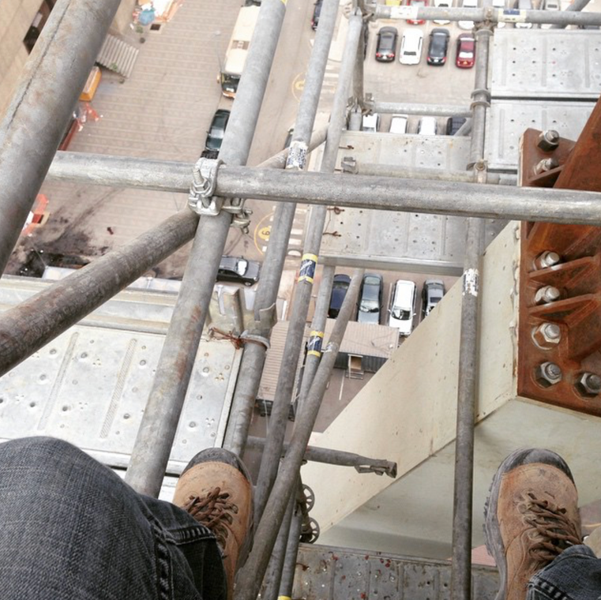

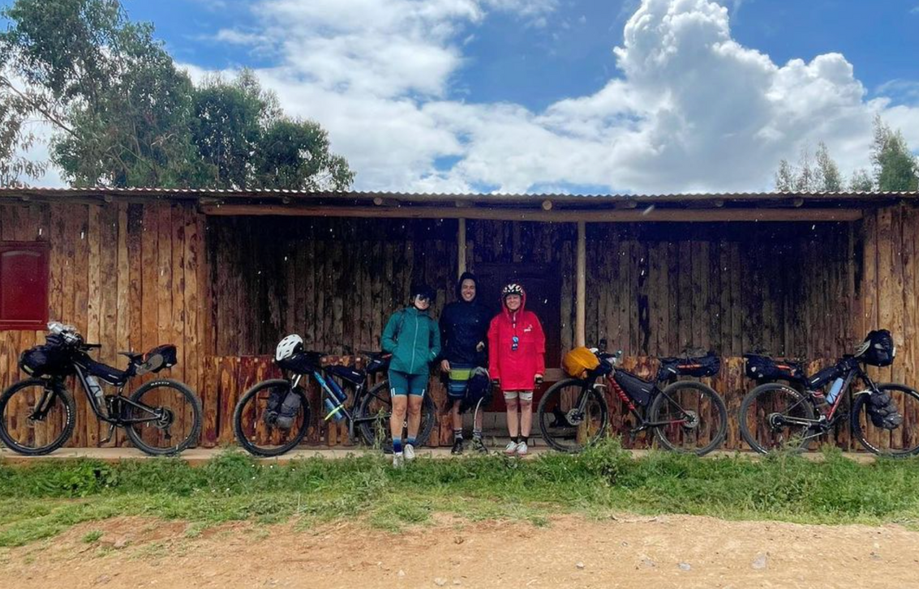
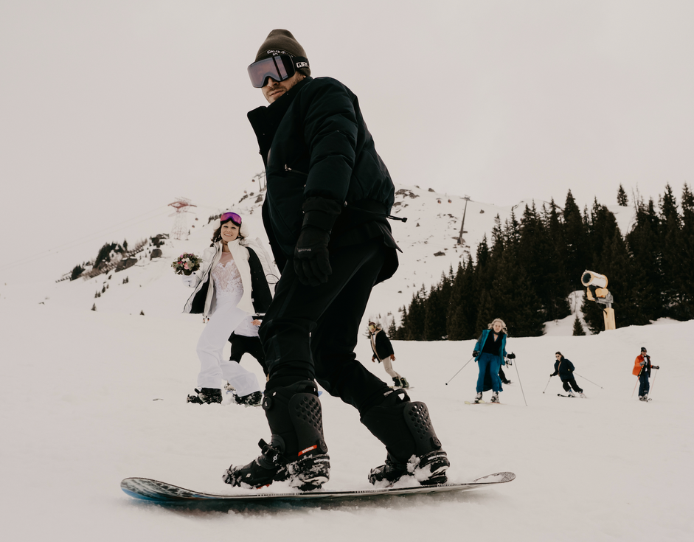
DIEGO (PERUVIAN)
12 YEARS OF EXPERIENCE
INTRODUCTION
MBA & MASTERS IN DATA
01
PROJECT MANAGEMENT, STRATEGIC PLANNING, & DATA ANALYSIS
Notes:
My name is Diego, and I'm originally from Peru. I bring over 12 years of experience in project management, strategic planning, and data analysis across various industries. My career began as a civil engineer leading large-scale projects, followed by founding Tierra Grande brewery in the food and beverage sector. I then worked for Novo, a brewery in San Diego, and most recently, I served as a city manager for Uber Eats in the Bay Area. Outside of work, I am passionate about surfing, biking, and snowboarding.

Slide 4
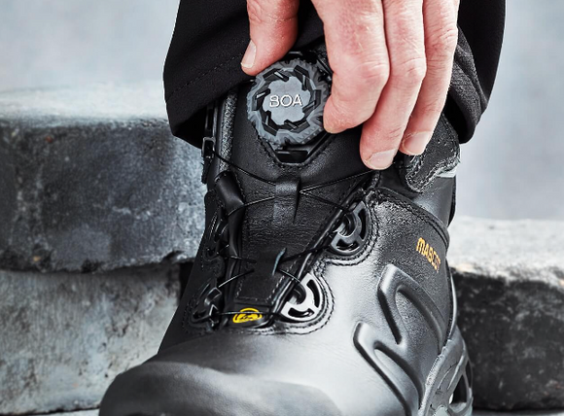
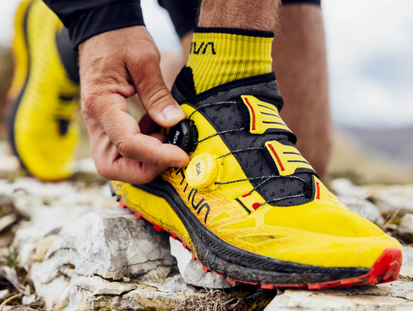
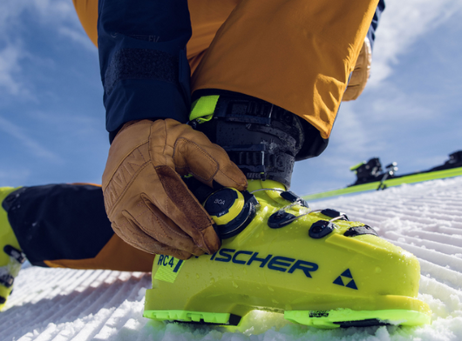
CONTEXT
SALES DATA (GIVEN)
02
POPULATION DATA
TASKS
BOA BUSINESS INSIGHTS
STRATEGIC BUSINESS ANALYSIS
LONG TERM BUSINESS PLANNING
Notes:
First, let me provide a brief overview of the data set. The data includes both qualitative and quantitative variables. The key variables we will focus on are Region, Brands, Revenue, Quantity Sold, Segments, and the BOA System. Additionally, I explored some population data to determine market sizes.
The assignment is divided into three main parts:
BOA Business Insights - The goal is to analyze the data and draw 5-10 insights regarding the BOA business in these regions.
Strategic Business Planning - Here, we need to consider how we think about BOA and why we might be more or less successful in different segments.
Long-Term Business Planning - The objective here is to create a workbook or data model that separates the input structure from the output to simplify user experience for manual data entry, manipulation, and visualization.
Each part has its specific goals and objectives, which we will discuss in detail.

Slide 5
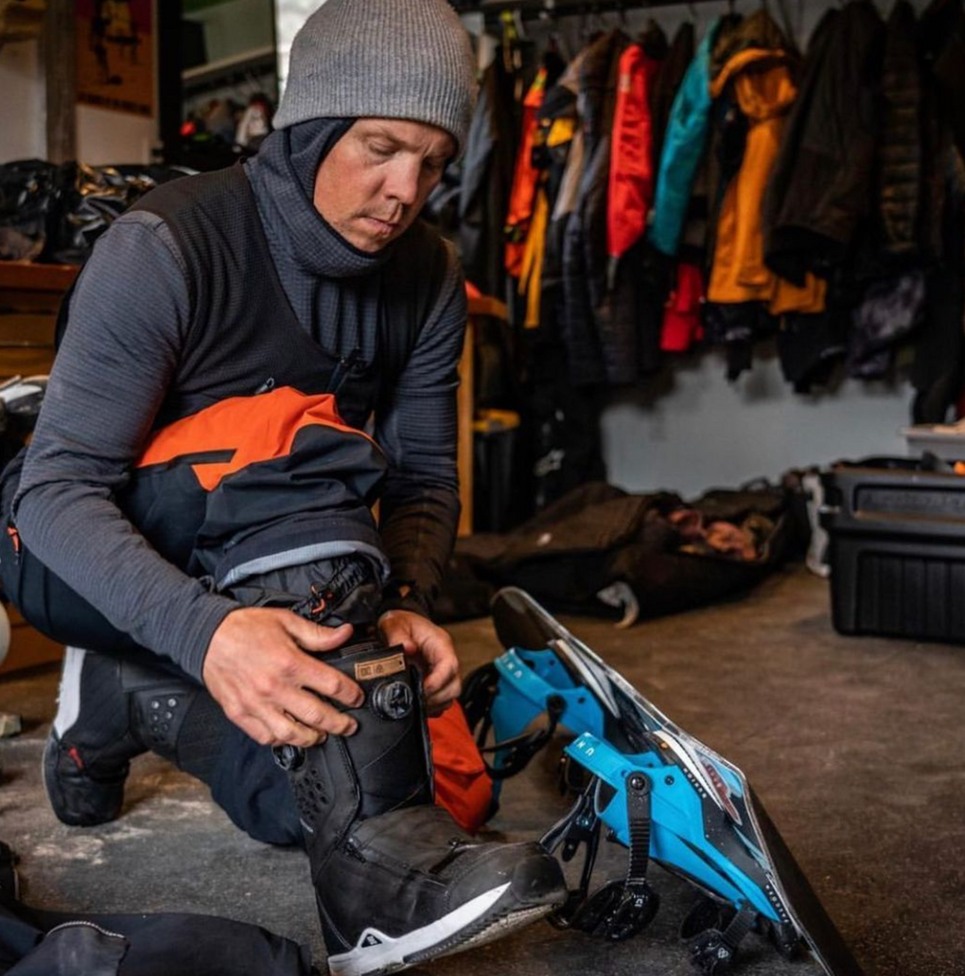
METHODOLOGY
03
DATA ASSUMPTIONS
0 = NO PROFIT, NEGATIVE VALUES = PROFIT LOSS
CLEANING DATA
FILTERED VALUES QTY = 0
DATA TRANSFORMATION
CALCULATED QTY/REVENUE & REVENUE/QTY
DATA ANALYSIS
INVESTIGATED REVENUE BY REGION, SEGMENT, CATEGORY, BRAND, & PRODUCT TYPE.
Notes:
To analyze the data, I followed these steps:
Data Assumptions - Making necessary assumptions to fill in gaps or inconsistencies in the data.
Cleaning Data - Ensuring the data is accurate and ready for analysis by removing or correcting any errors.
Data Transformation - Converting the data into a format suitable for analysis.
Data Analysis - Applying various analytical techniques to draw meaningful insights.

Slide 6
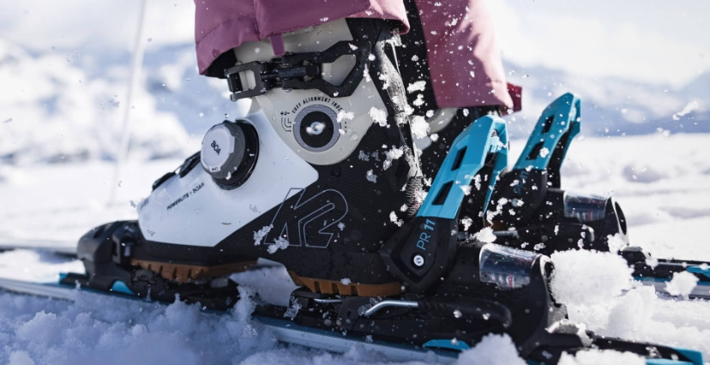
BUSINESS INSIGHTS
04
02
03
Strategic Resource Allocation (EMEA, Global Insight)
Allocate resources and investment strategically based on regional performance. Prioritize EMEA for expansion and innovation, while focusing on improving profitability in Asia and addressing the challenges in America.
Top Categories Contributing to Revenue (Global Insight)
Given its significant contribution to revenue, workwear, athletic kids, golf, and cycling should be a priority for future investments in research and development, marketing, and production capabilities
Revenue Growth per year.
Since year 2020, revenue growth approximately 27% per year.
01
04
27%
4
Revenue to Qty Ratio, Most Profitable Market (EMEA).
With the highest revenue-to-quantity ratio of 2.9, EMEA is our most profitable market. This indicates that products in this region are either sold at higher prices, have higher margins, or both. Strategies that are working well in EMEA could be analyzed and potentially applied to other regions
0.77
Revenue to Qty Ratio, Most Challenging Market (Americas).
With the lowest ratio of 0.77, America presents the greatest challenge in terms of profitability. This could indicate lower pricing power, higher costs, or competitive market conditions.
10.3
Mio USD Market Leader in Workwear (EMEA)
Workwear generated 10.3 million USD in EMEA in 2022, making it the most profitable segment, highlights the company's strong market position and dominance in this category within the region.
2.84
0.77
10.3
06
Notes:
The six insights I derived are as follows:
Since 2020, revenue has grown approximately 27% per year.
2. Allocate resources and investments strategically based on regional performance. Prioritize EMEA for expansion and innovation, while focusing on improving profitability in Asia and addressing the challenges in America.
3. Given its significant contribution to revenue, workwear, athletic kids, golf, and cycling should be a priority for future investments in research and development, marketing, and production capabilities.
4. With the highest revenue-to-quantity ratio of 2.9, EMEA is our most profitable market. This indicates that products in this region are either sold at higher prices, have higher margins, or both. Strategies that are working well in EMEA could be analyzed and potentially applied to other regions.
5. With the lowest revenue-to-quantity ratio of 0.77, America presents the greatest challenge in terms of profitability. This could indicate lower pricing power, higher costs, or competitive market conditions.
6. Workwear generated 10.3 million USD in EMEA in 2022, making it the most profitable segment, highlighting the company's strong market position and dominance in this category within the region.

Slide 7
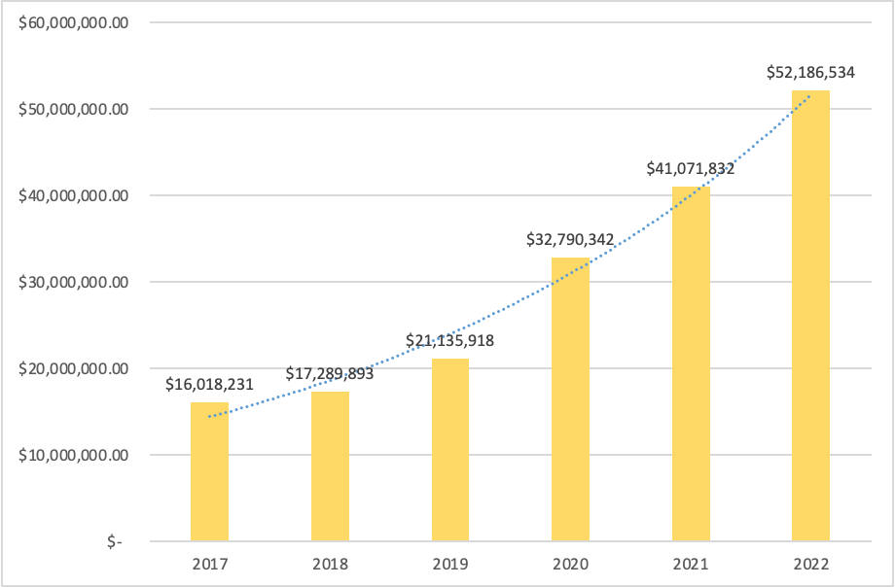
REVENUE GROWTH PER YEAR
+27%
+26%
Notes:
Since 2020, revenue has grown approximately 27% per year.

Slide 8
REVENUE GROWTH PER REGION
REGIONAL REVENUE GROWTH PER YEAR
REGIONAL QUNATITY SOLD PER YEAR
2022 REVENUE TO QUANTITY RATIO. 2.84 EMEA, 1.22 ASIA, & 0.77 AMERICAS
Notes:
In 2022, the revenue-to-quantity ratio was as follows:
EMEA: 2.84
ASIA: 1.22
AMERICAS: 0.77

Slide 9
2022 REVENUE BY SEGMENT
Notes:
The best segments of BOA based on revenue are Workwear, Athletic Kids, Golf, and Cycling.

Slide 10
EMEA 2022 REVENUE BY SEGMENT
Notes:
BOA's best segment in EMEA is Workwear, contributing 10.2 million USD in revenue.

Slide 11
STRATEGIC BUSINESS ANALYSIS
05
SCORES BY SEGMENT
Notes:
To guide our strategic business planning, I used a scoring system for each criterion based on data, research, and my perception of how BOA is perceived in each segment. Scores above 22 indicate the most attractive markets.
I created a matrix considering variables such as Risk Analysis, Brand Reputation, Revenue Score, Market Potential, Competitive Landscape, and Economic Conditions.
This matrix helps us understand the strategic positioning of BOA in different segments.
Based on the matrix, here are some key insights:
- The segments I suggest to pursue are Snow Sports, Workwear, Cycling, and Kids.
- The segments we should consider discontinuing are Trail Run, Baseball, Training, and Road Running."

Slide 12
RISK SCORE. SCORE COMES FROM RISK ANALYSIS PERFROM IN EACH CATEGORY. IDEALLY IT WOULD BE DATA COLLECTED FROM THE EXPERTS IN EACH FIELD.
BRAND REPUTATION. ASOCIATED TO MY PERCEPTION, REVENUE, & QTY SOLD.
CRITERIAS
REVENUE SCORE. TOTAL AMOUNT OF REVENUE IN 2022.
MARKET POTENTIAL. SIZE & GROWTH OF THE MARKET SEGMENT.
COMPETITIVE LANDSCAPE. LEVEL OF COMPETITION & BOA’S RELATIVE STRENGTH.
ECONOMIC CONDITIONS. ASSES THE ECONOMIC STABILITY & GROWTH.
Notes:
The criteria used were:
Risk Score - Based on risk analysis performed in each category.
Brand Reputation - Associated with my perception, revenue, and quantity sold.
Revenue Score - The amount of revenue in 2022.
Market Potential - The size and growth of the market segment.
Competitive Landscape - The level of competition and BOA’s relative strength.
Economic Conditions - Assessing the economic stability and growth.

Slide 13
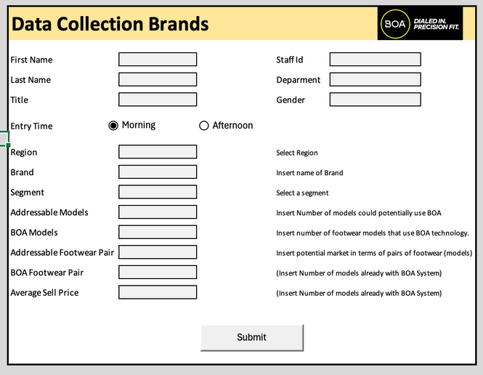
LONG-TERM BUSINESS PLANNING
05
DATA COLLECTION FORM, USE TO EASY DATA ENTRY
Notes:
For Part 3. The task was to create a model which simplifies data entry, manipulation and visualization.
So First I created a form to simplify user experience for manual data entry.

Slide 14
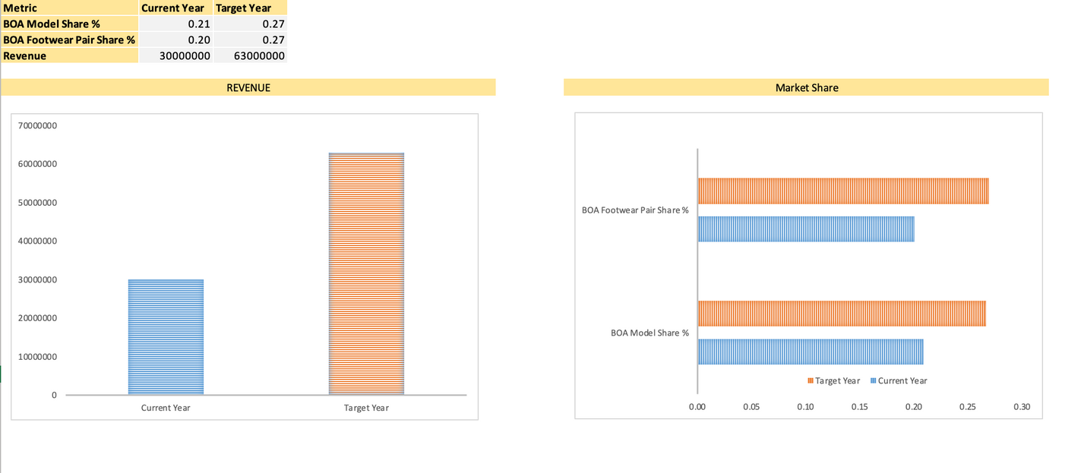
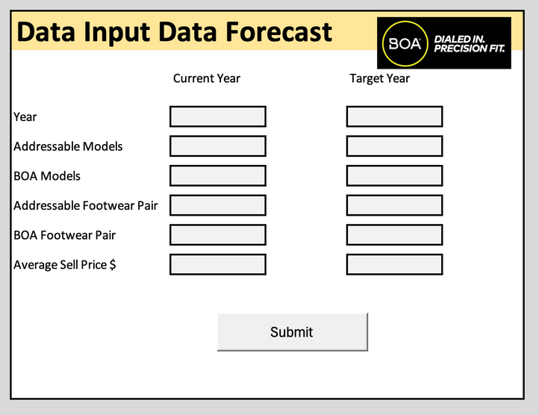
INPUT MODEL (BOA VARIABLES)
05
Notes:
Then I created a Data model for inputting the BOA Variables, and getting some automatic visualizations and metrics.

Slide 15
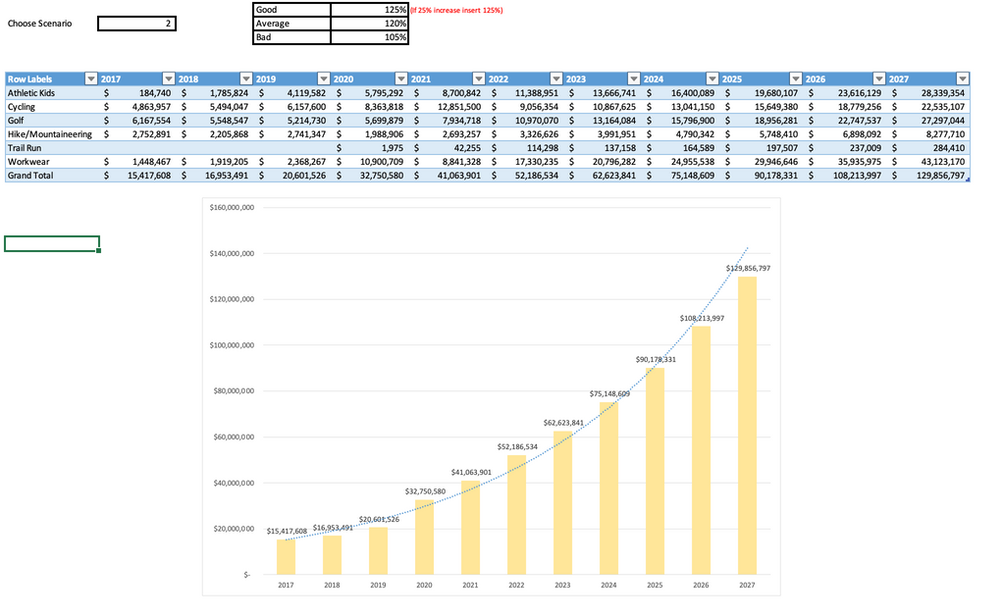
FORECASTING SCENARIOS MODEL
05
Notes:
Data model for forecasting scenarios.
In the scenarios forecasting, you only need to enter the % for Good, Average or Bad, and the select your scenario (1,2,3). The model will automatically calculate the revenue forecast and made a visualization.
With this 3 tools, will allow BOA to plan the short-term and long-term goals of the company.

Slide 16
THANK YOU
Notes:
Thank you for your attention. I am now open to any questions you may have.

Slide 17
APPENDIX

Slide 18
SWOT ANALYSIS
Strengths | Weaknesses | Opportunities | Threats
Innovative Design Precision Fit Ease of Use Durability Versatility Strong Brand Partnership | Cost Complexity Perception Replacement and Repairs (When damage is on based plate) Market Niches Compatibility | Expansion into New Markets (Latam) Tech Advancements Sustainability Customization Options Increased Consumer Awareness New Partnerships (Fashion, More affordable options) Integration with smart tech (GPS) | Emerging Competition Economic Downturns Product Failures Consumer Preferences Patent Expiration Supplier Dependance Regulatory Changes

Slide 19

COMPETITOR ANALYSIS
 | Precision Fit | Dial (Similar to Boa) | Easy Use (Fit and Release) | Affordability | Repair Complexity
Salomon QuickLace
Caterpy
Lock Laces
Didalace |  |  |  |  | Need New Device
Hickies
Airtox (SafetyBoots)

